Slide 1




Clean Energy for Sustainable Power Production in U.S. Analysis
Sayed Ahmed Alalawi
DAB 16

Slide 2




Scenario
Sustainable energy is one of the key SDGs that Bahrain aims to achieve by 2050. To move toward this objective, the country is reducing its reliance on natural gas by integrating renewable power sources into its energy mix. The United States, one of the global leaders in renewable energy deployment, offers valuable insights and best practices. Studying the U.S. experience can help Bahrain identify effective strategies and adapt suitable technologies.

Slide 3

Approaches
Which type of energy source demonstrates the highest operational performance?
Which type of energy source generates the greatest amount of electricity?
Which type of energy source is the most economically and technically feasible to develop?
In which U.S. states is each energy source type most highly concentrated?
Which type of renewable energy is most suitable for deployment in Bahrain?

Slide 4


Technical Terminologies

Slide 5
Fuel Type Classification
Renewable
Non-Renewable
Carbon Free
Solar
Geothermal
Hydroelectric
Other Renewables
Wind
Coal
Natural Gas
Oil
Nuclear

Slide 6



Comparative Performance
Operational Performance
Infrastructure Comparison
Fuel Efficiency

Slide 7
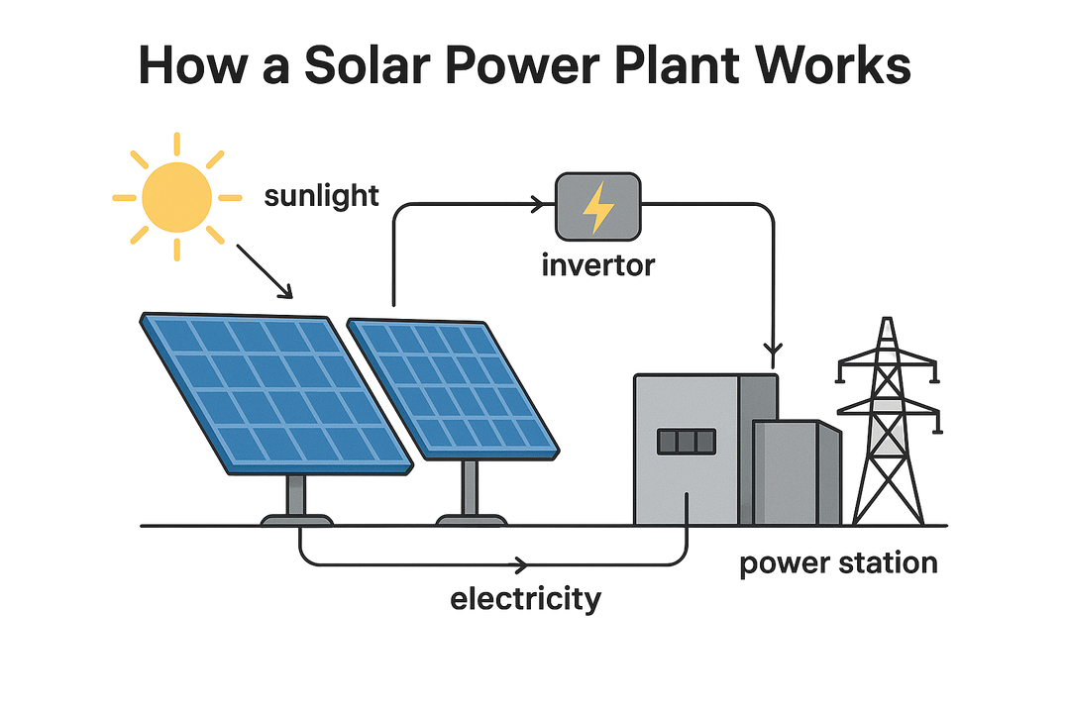
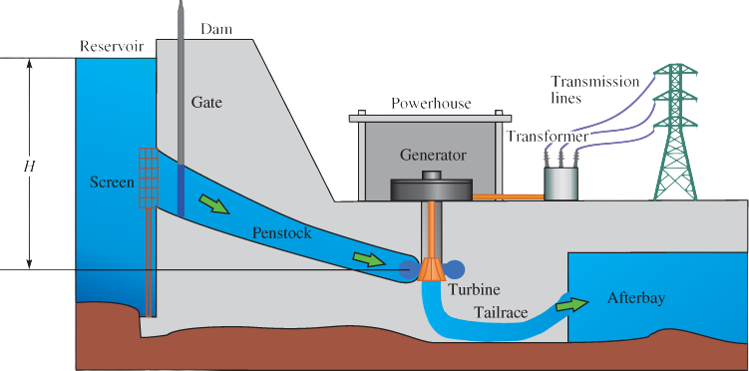
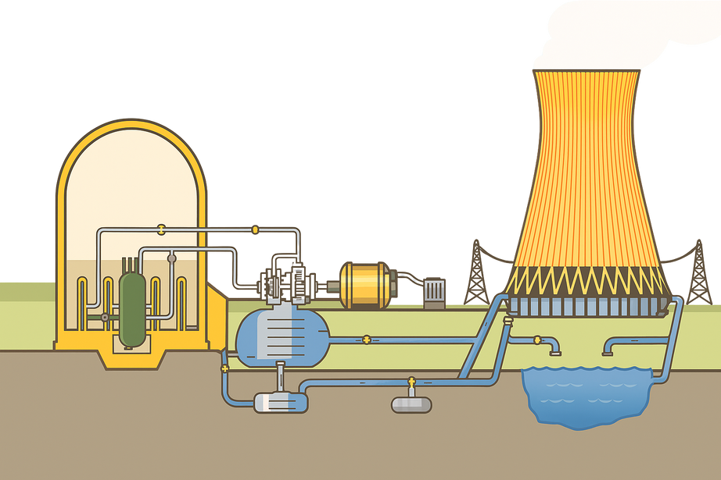
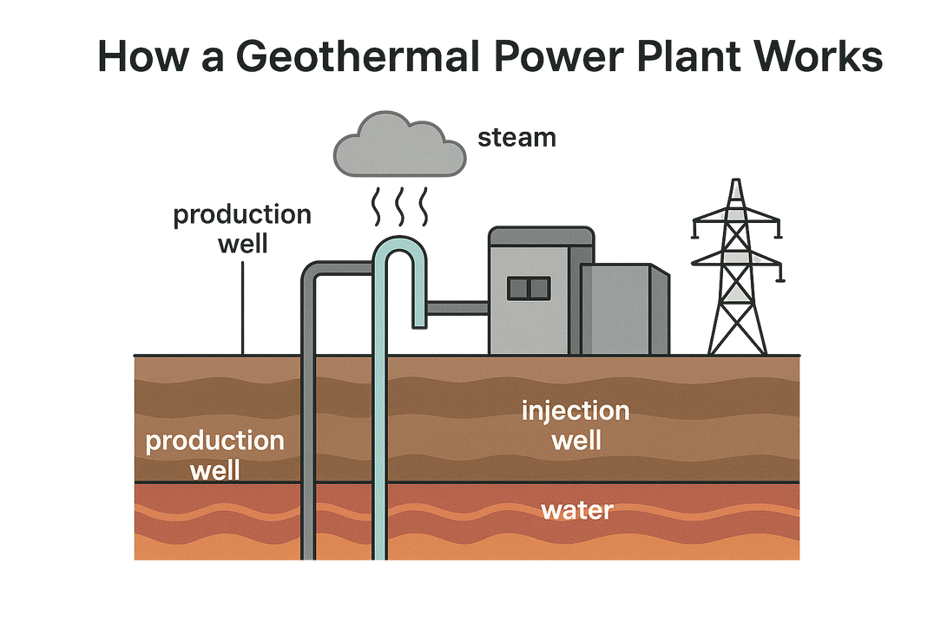
Energy Generation Process
Solar
Hydroelectric
Geothermal
Nuclear

Slide 8

Overall Comparison

Slide 9

Total Plants
Total Generation
14,247
4,308 TWh

Slide 10
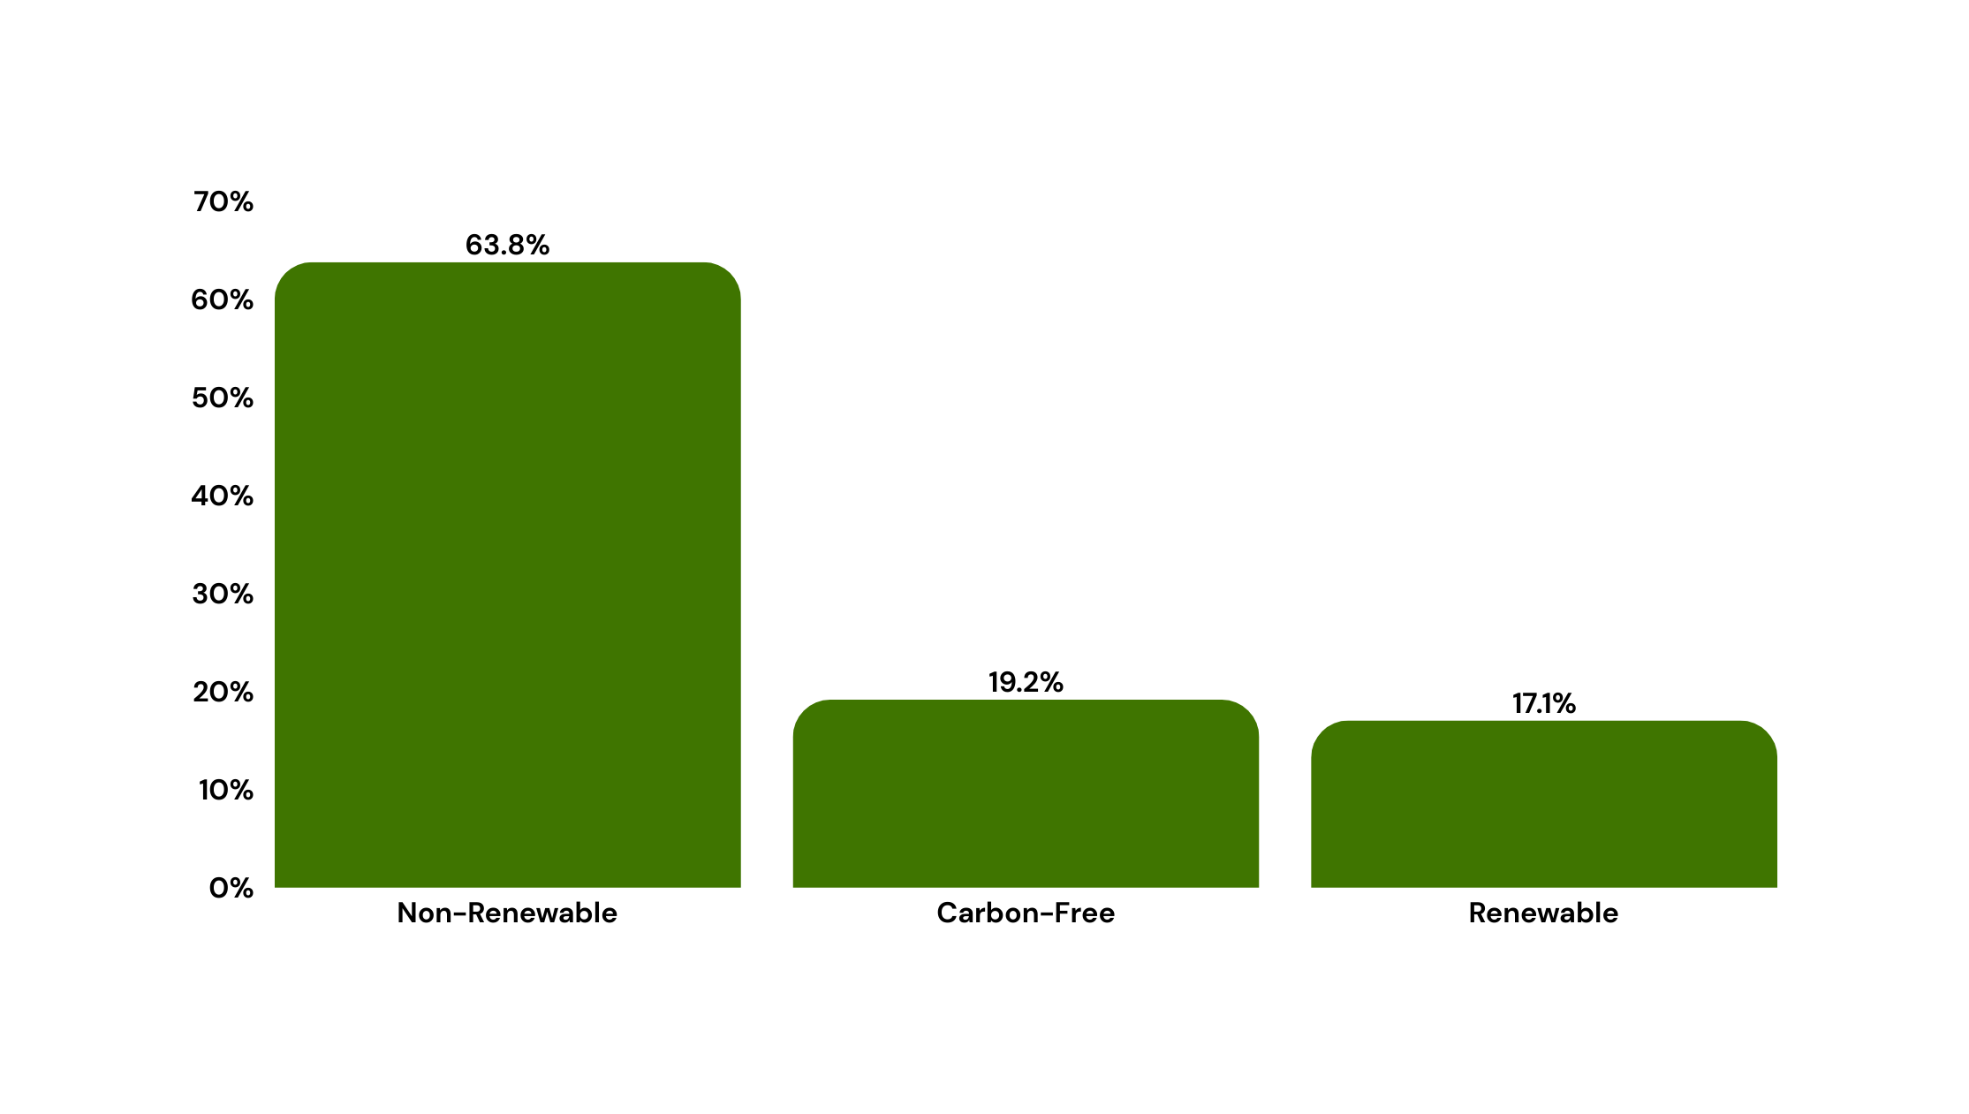
Contribution To US Power Production

Slide 11

Operational Performance
Fuel Utilized as Electricity
Efficiency
Total Fuel Consumed
Lost Fuel
Total Fuel
Consumed
Fuel Utilized
as Electricity

Slide 12
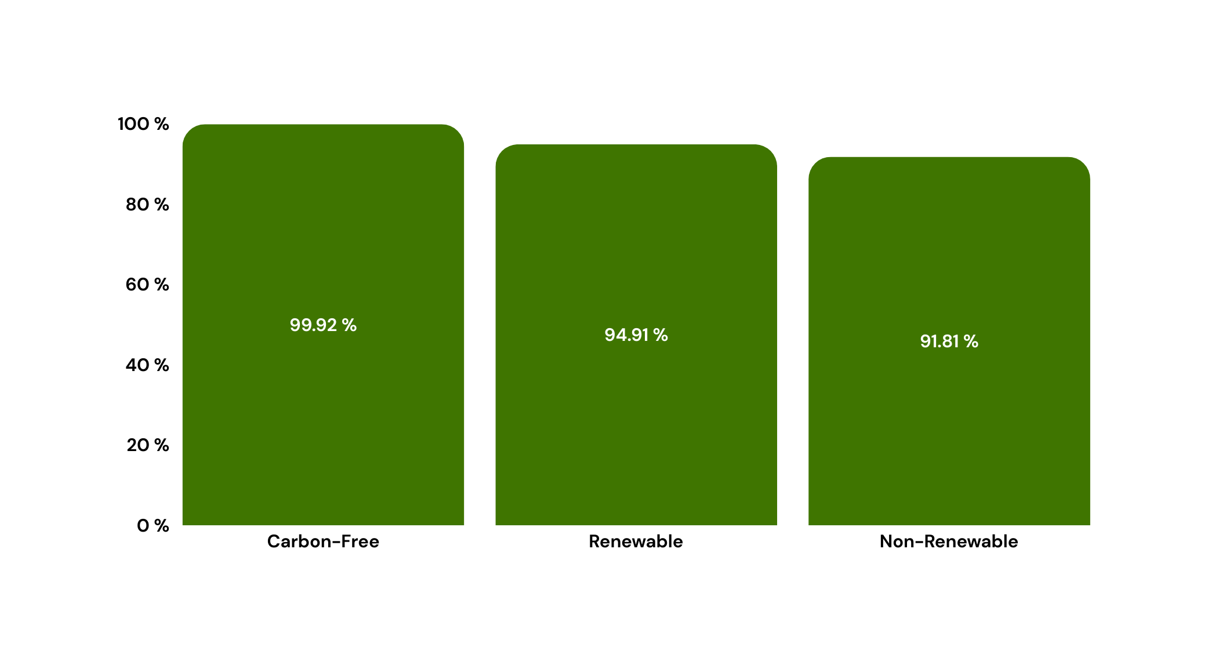
Operational Performance
Efficiency

Slide 13
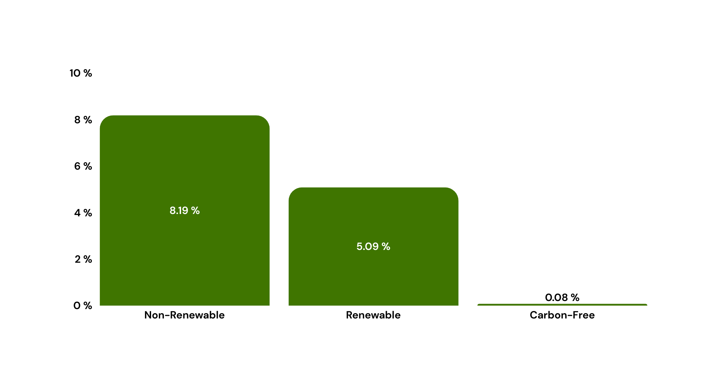
Operational Performance
Lost Fuel

Slide 14
Infrastructure Comparison
Total Plants Over Time
Plants Distribution
Electricity Generated / Area

Slide 15
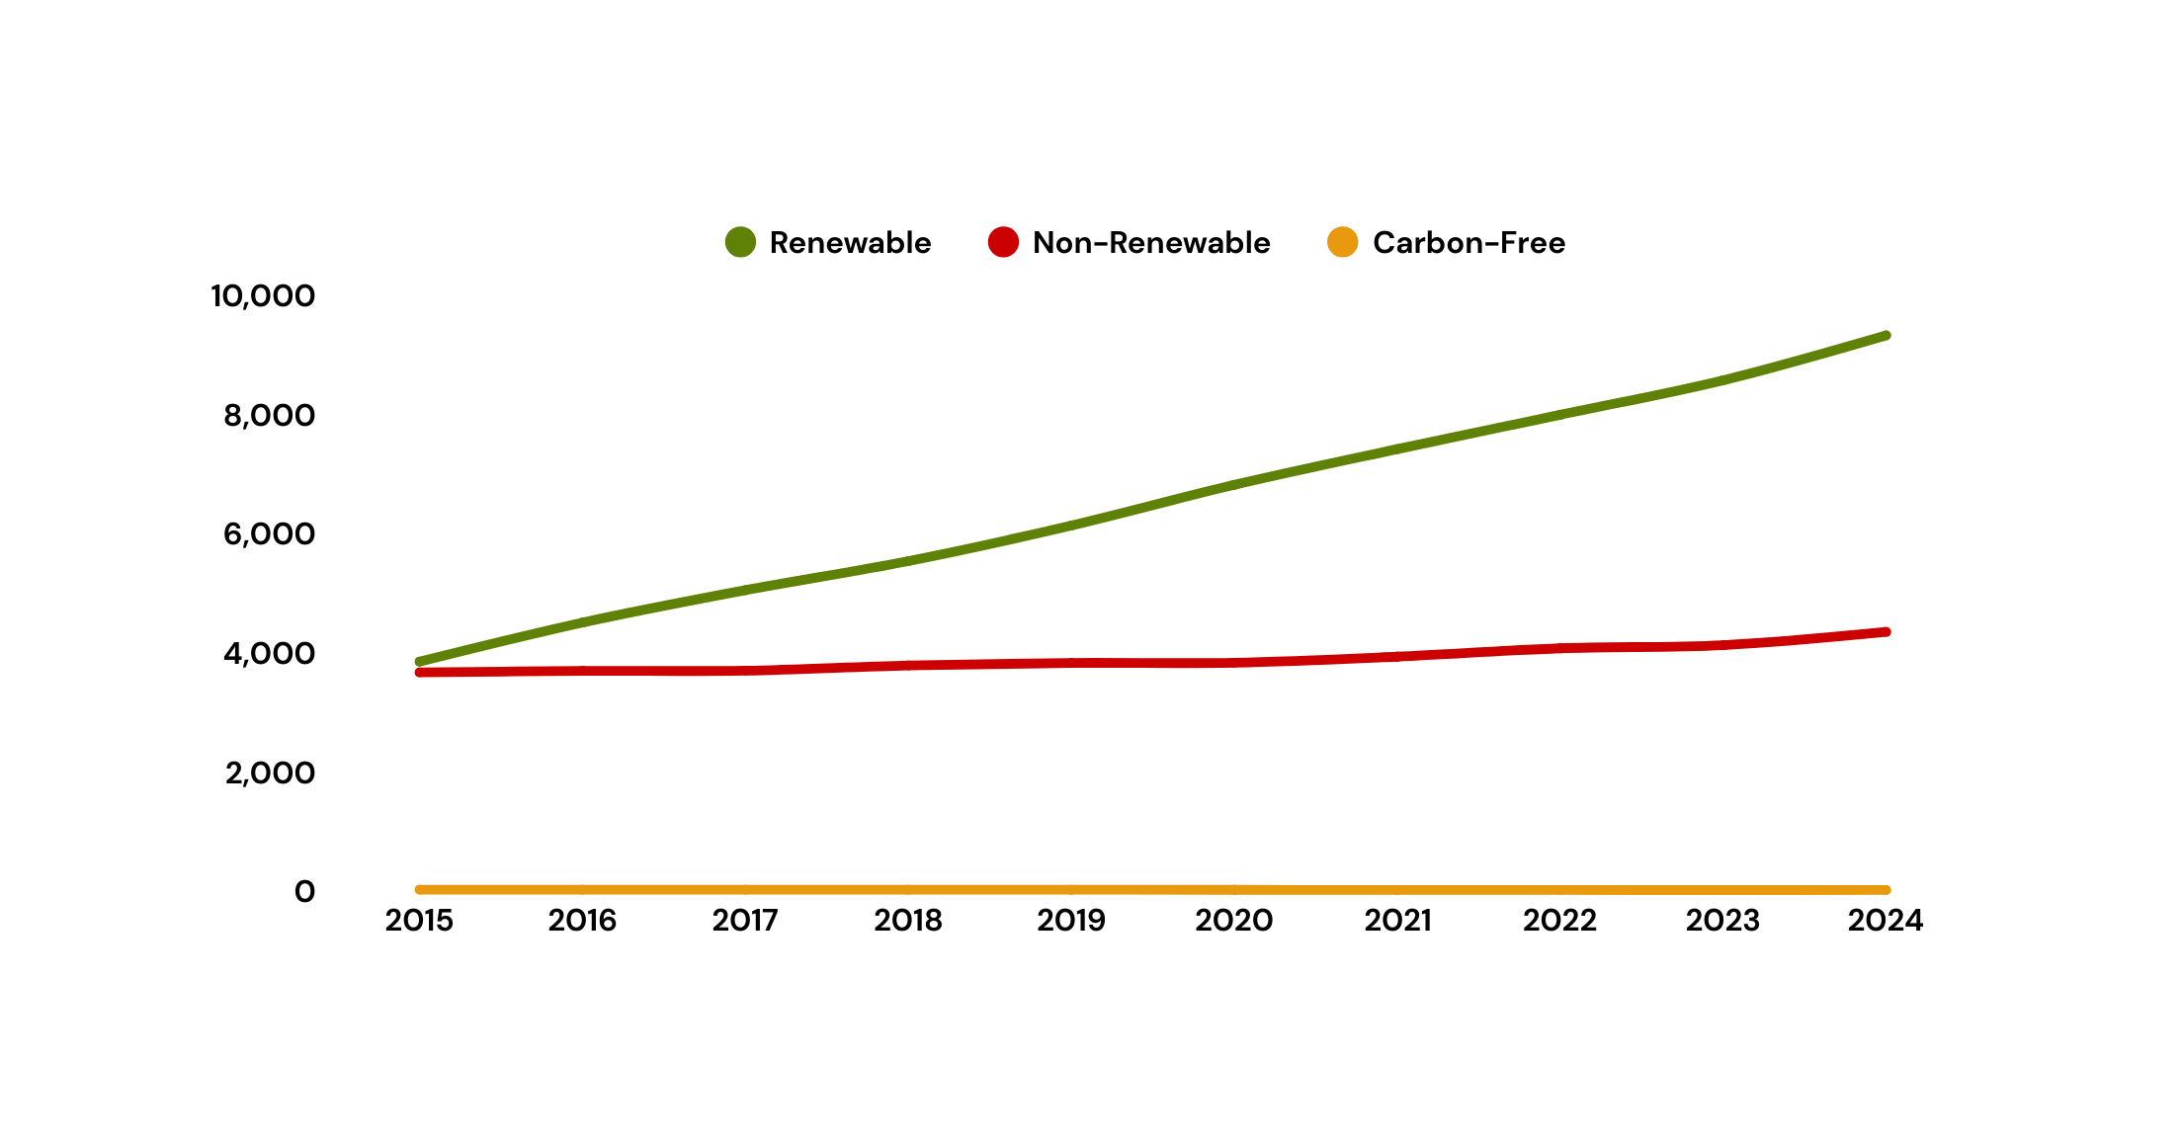
Infrastructure Comparison
Total Plants

Slide 16
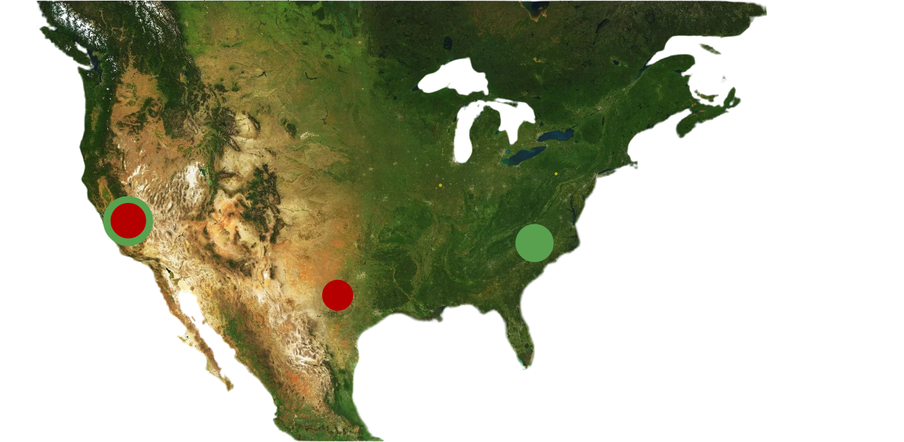
Infrastructure Comparison
Plant Distribution
Illinois
Pennsylvania
California
North Carolina
Texas

Slide 17
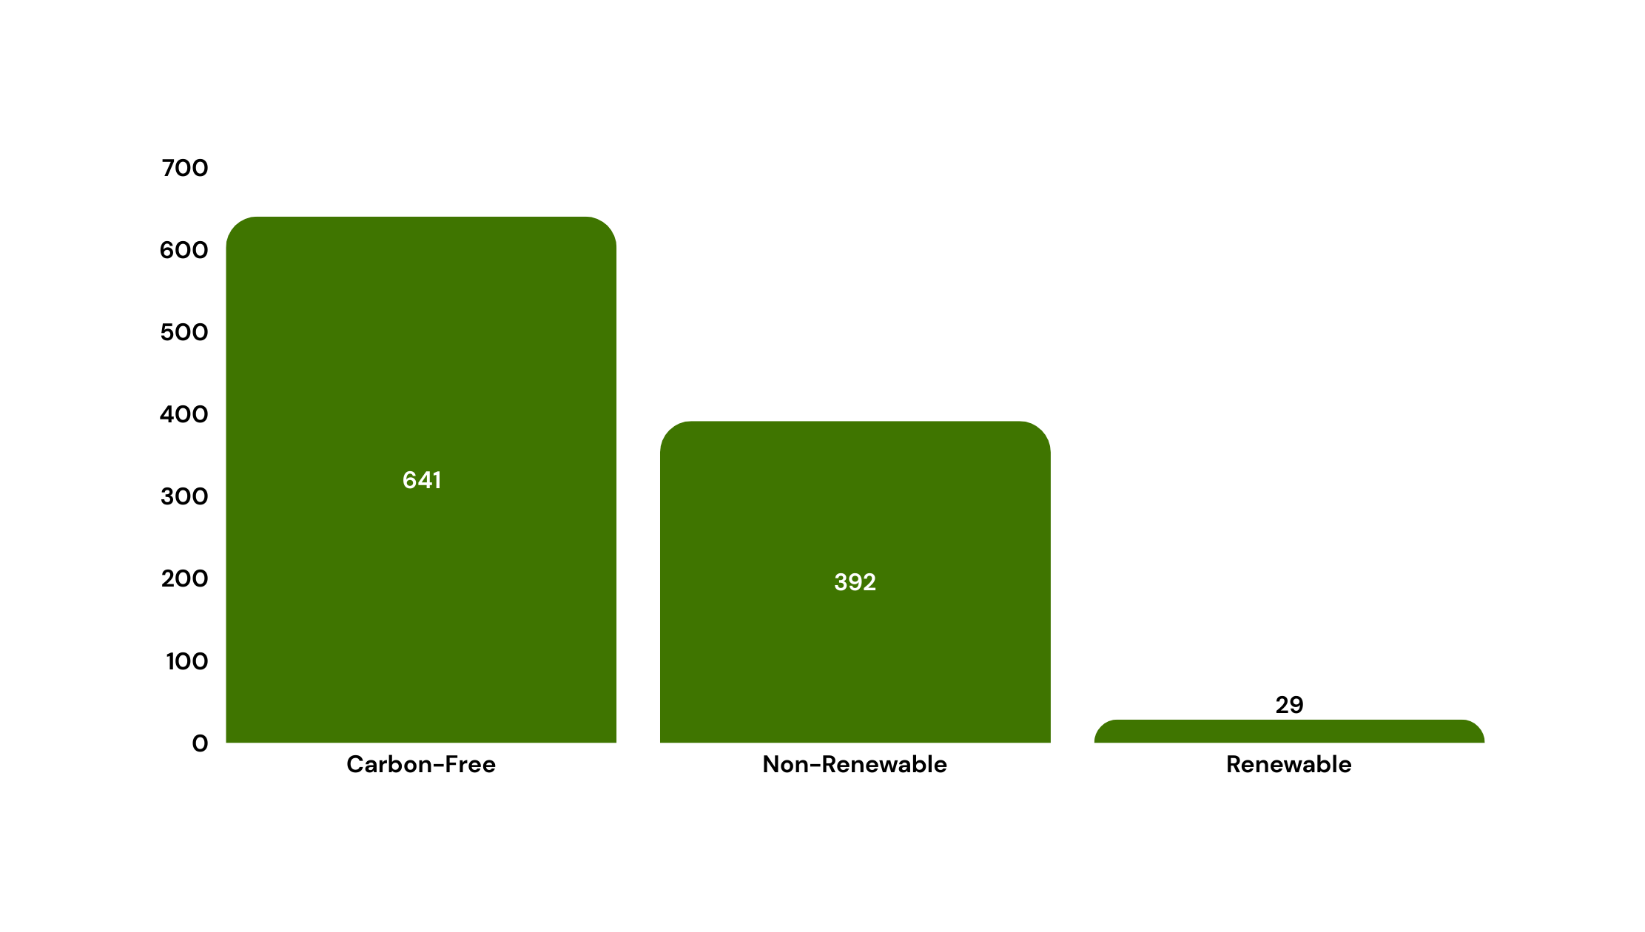

Infrastructure Comparison
Generation / Area (MWh/Km )

Slide 18
Heat Rate
Fuel Consumed (MMBTU)
Heat Rate
Electricity Produced (MWh)

Slide 19
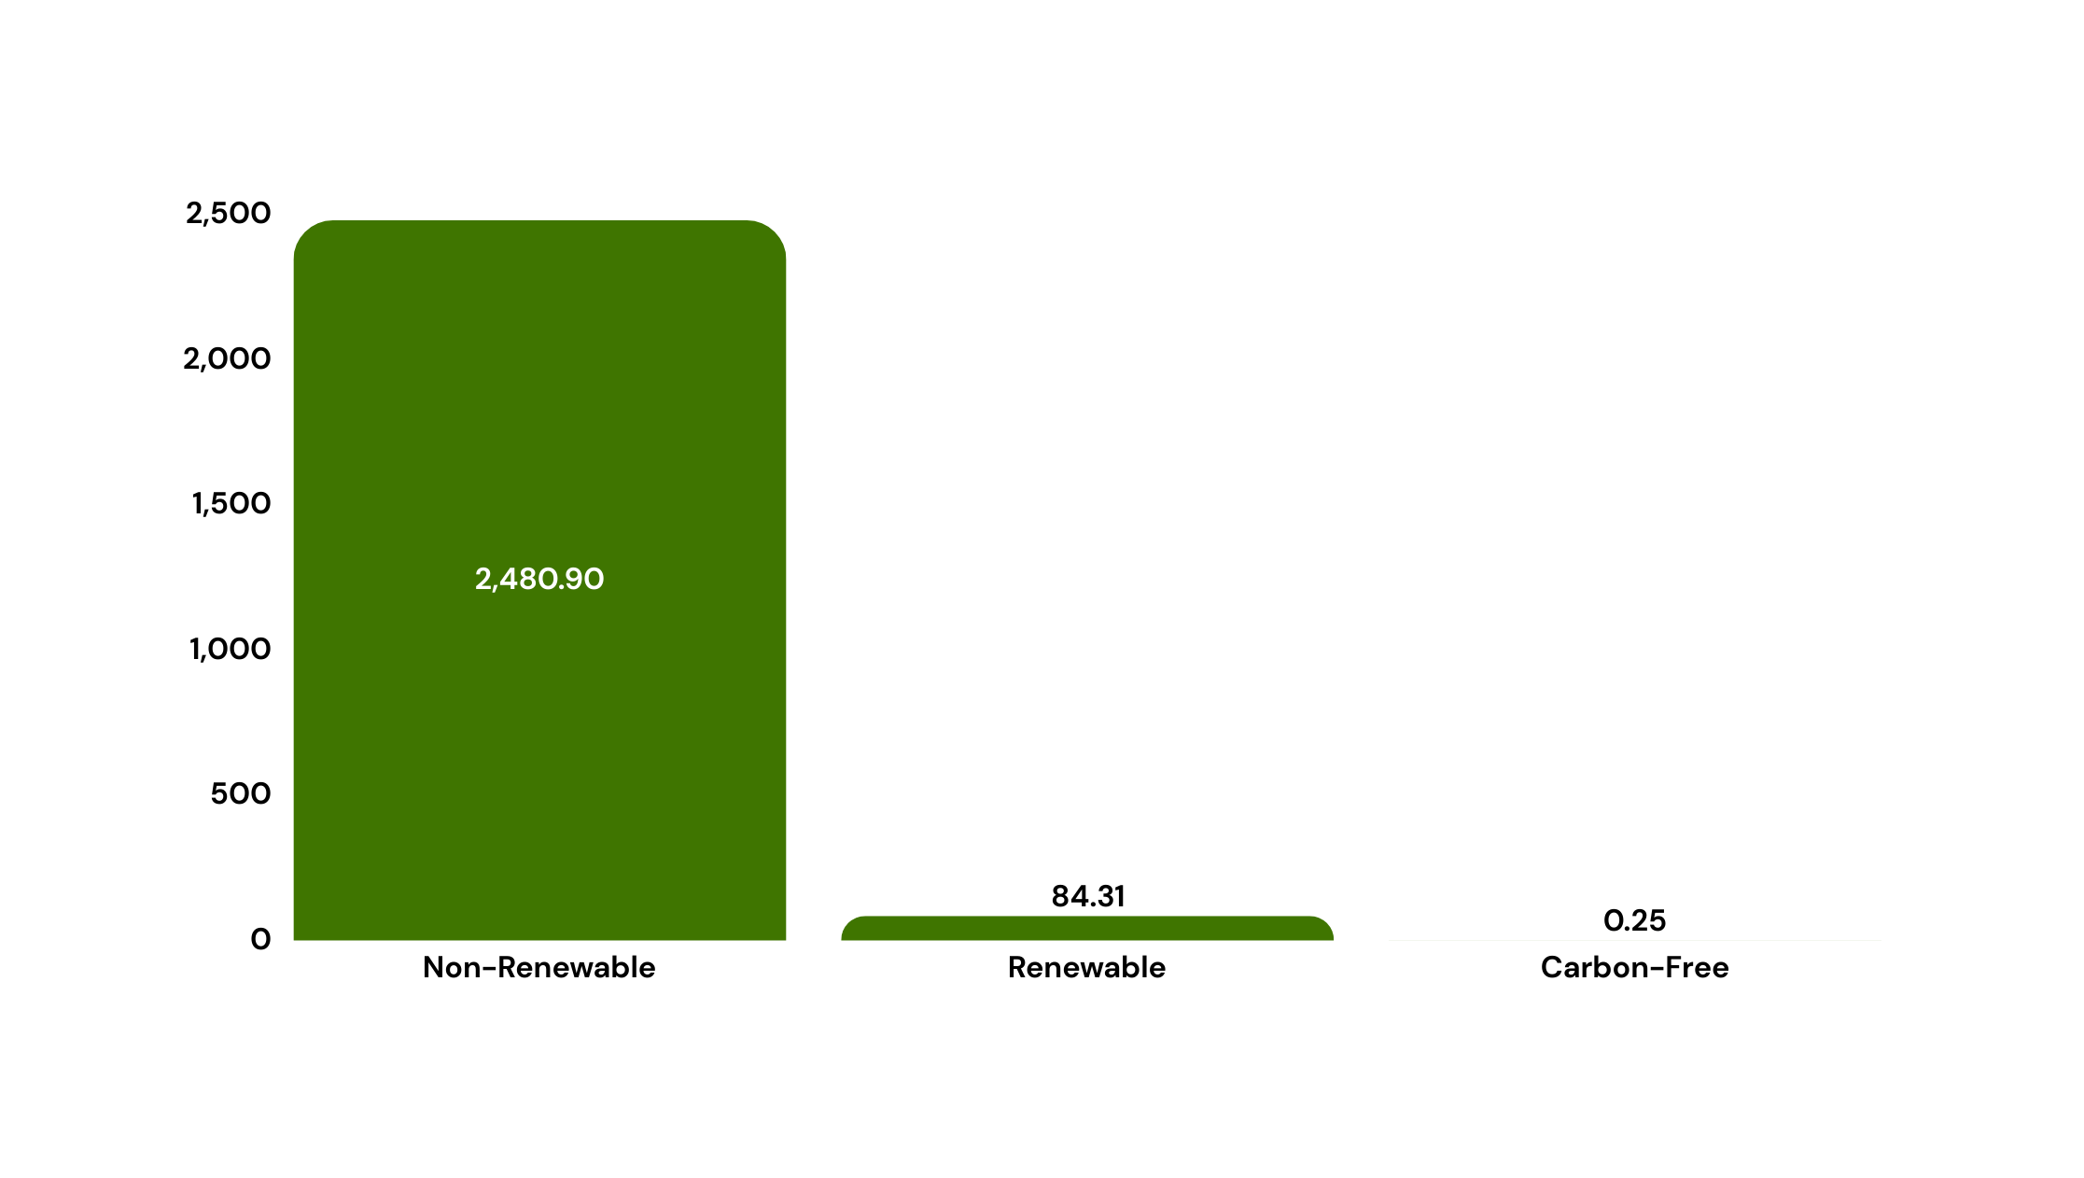
Heat Rate
(MMBTU/MWh)

Slide 20

Clean Energy Comparison

Slide 21
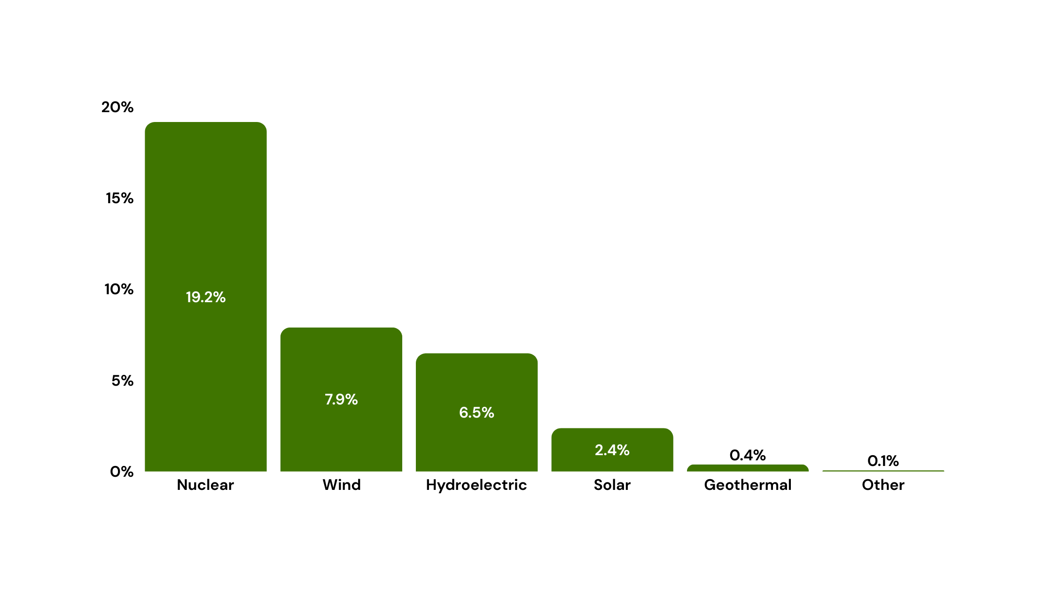
Contribution To US Power Production

Slide 22

Comparative Performance
Operational Performance
Infrastructure Comparison
Cost Analysis

Slide 23
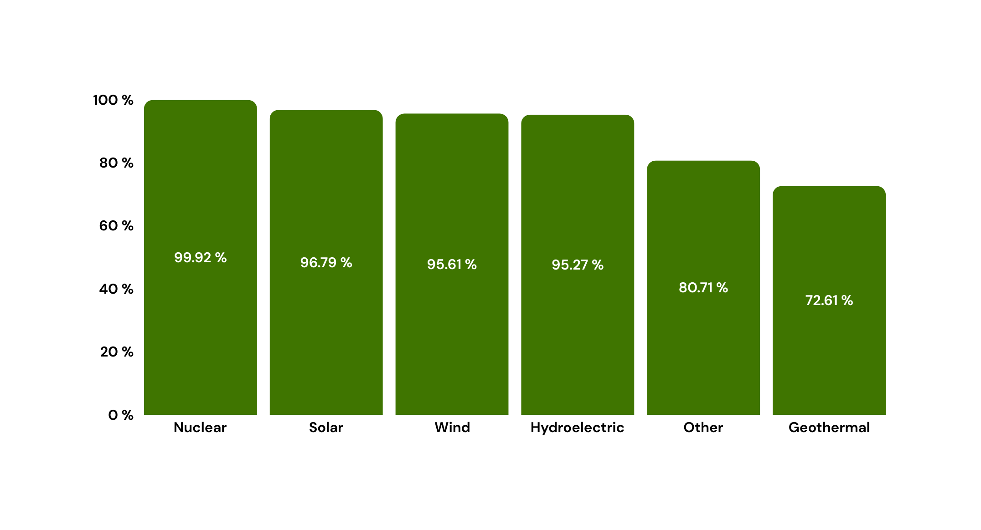
Operational Performance
Efficiency

Slide 24
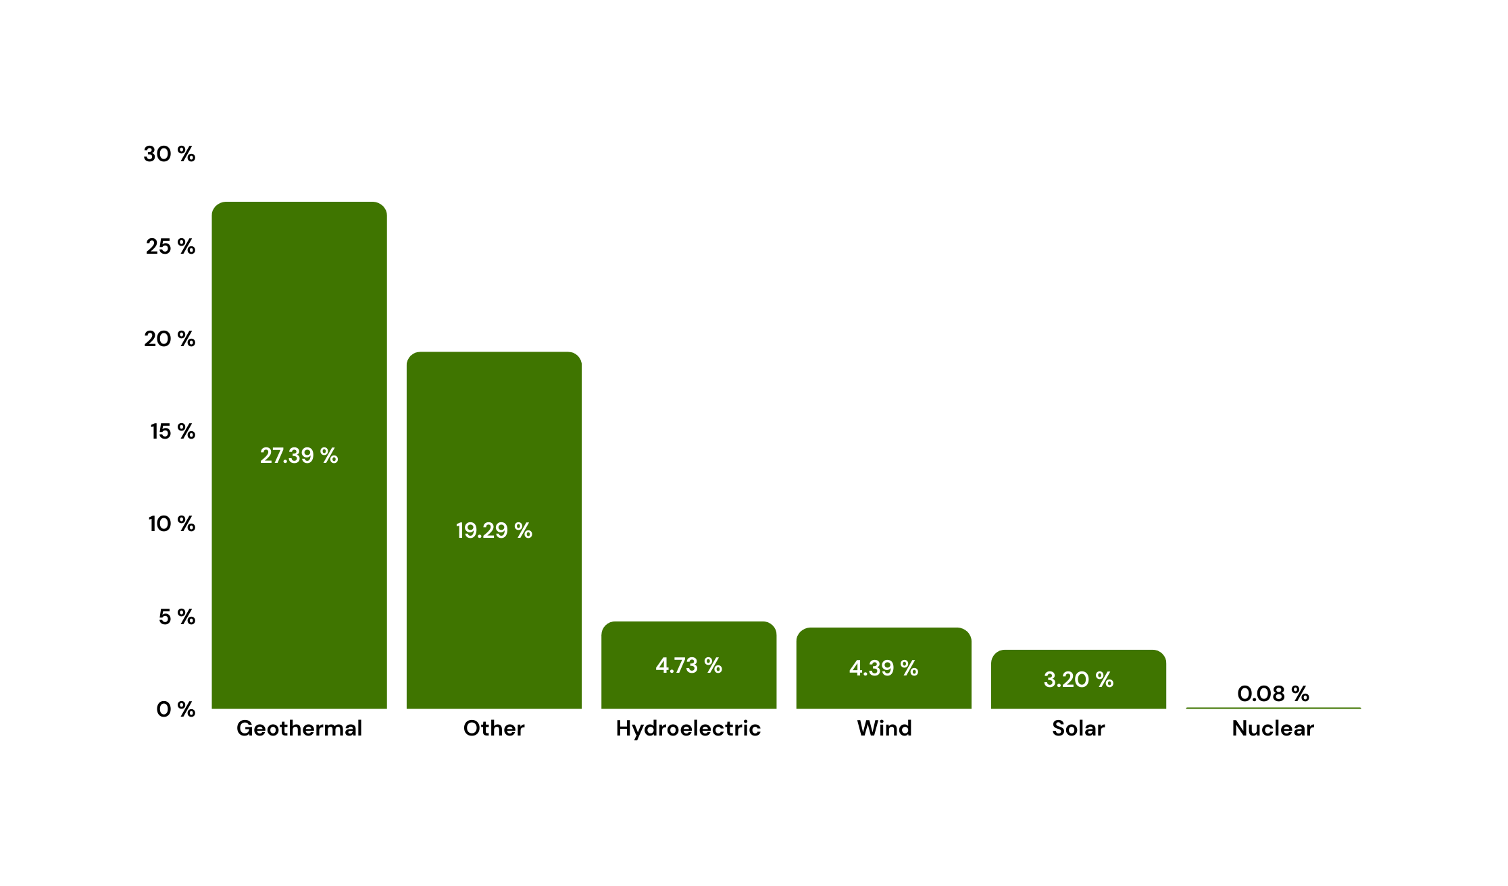
Operational Performance
Lost Fuel

Slide 25
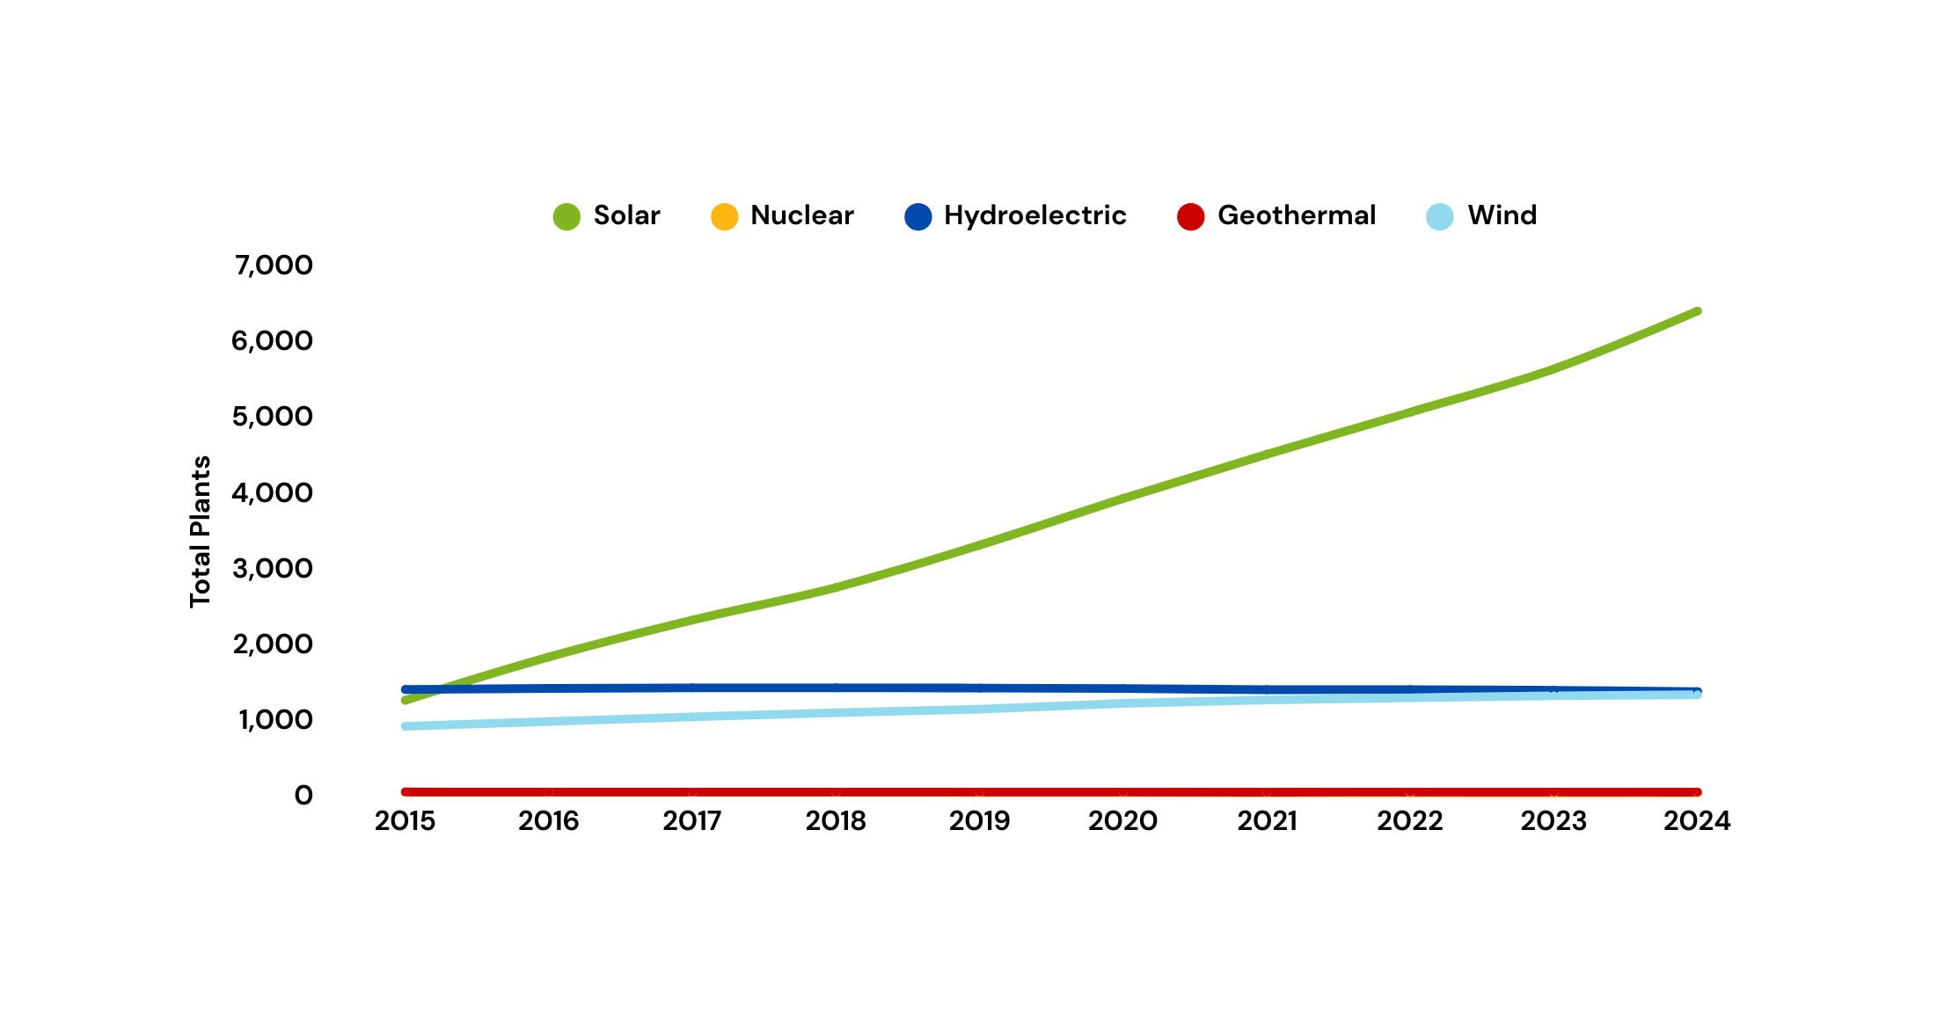
Infrastructure comparison
Total Plants
6,413
1,275

Slide 26
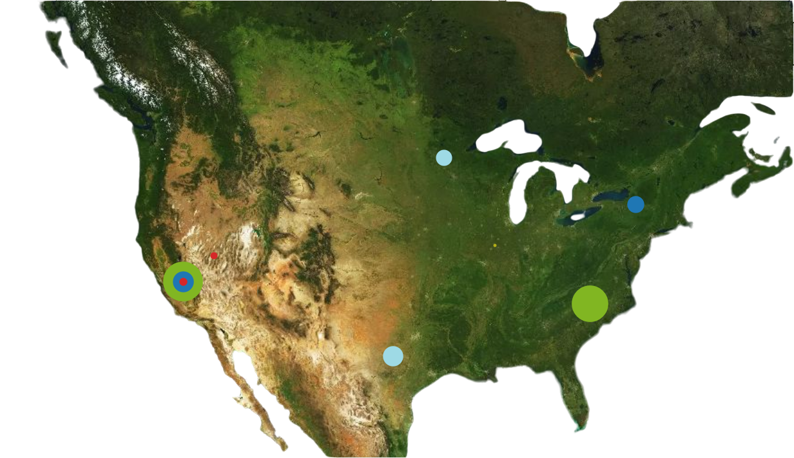
Infrastructure comparison
Plants Distribution
Minnesota
New York
Nevada
Illinois
California
North Carolina
Texas

Slide 27
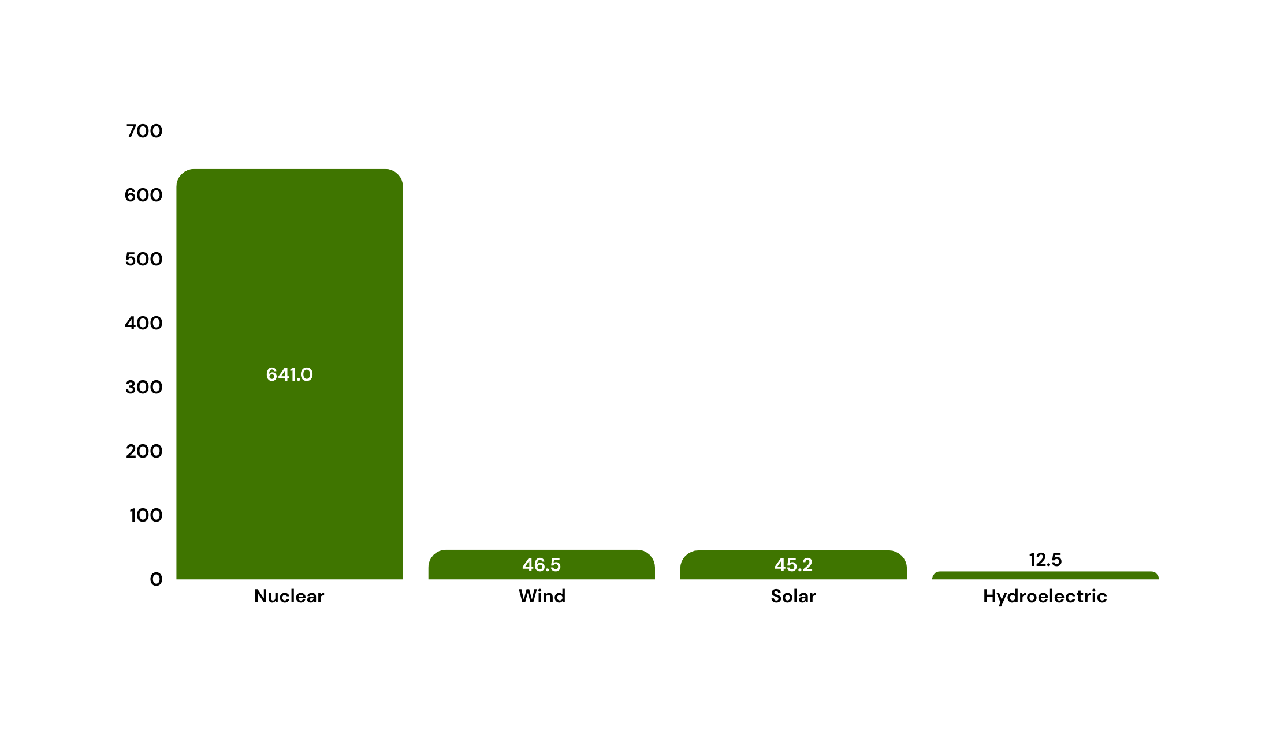
Infrastructure comparison
Generation / Area (MWh/Km )

Slide 28
Cost Analysis
Fuel Consumed (MMBTU)
Operational Cost =
Electricity Produced (MWh)
Energy Type | Variable Cost
Geothermal | $ 27/ MWh
Nuclear | $ 31 / MWh
Hydroelectric | $ 8 / MWh
Wind | $ 15 / MWh
Solar | $ 11 / MWh

Slide 29
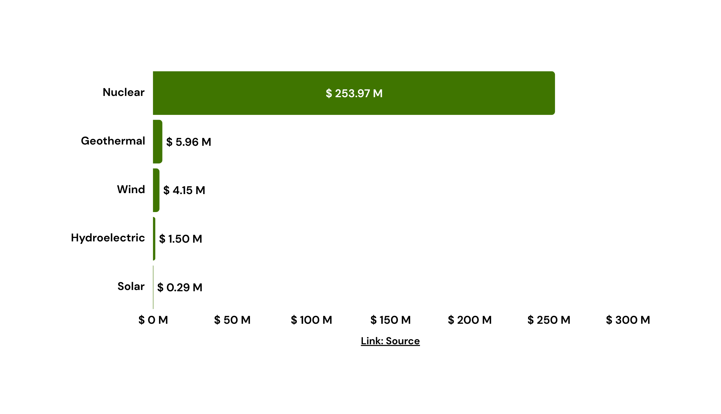
Operational Cost

Slide 30


Bahrain Vision

Slide 31
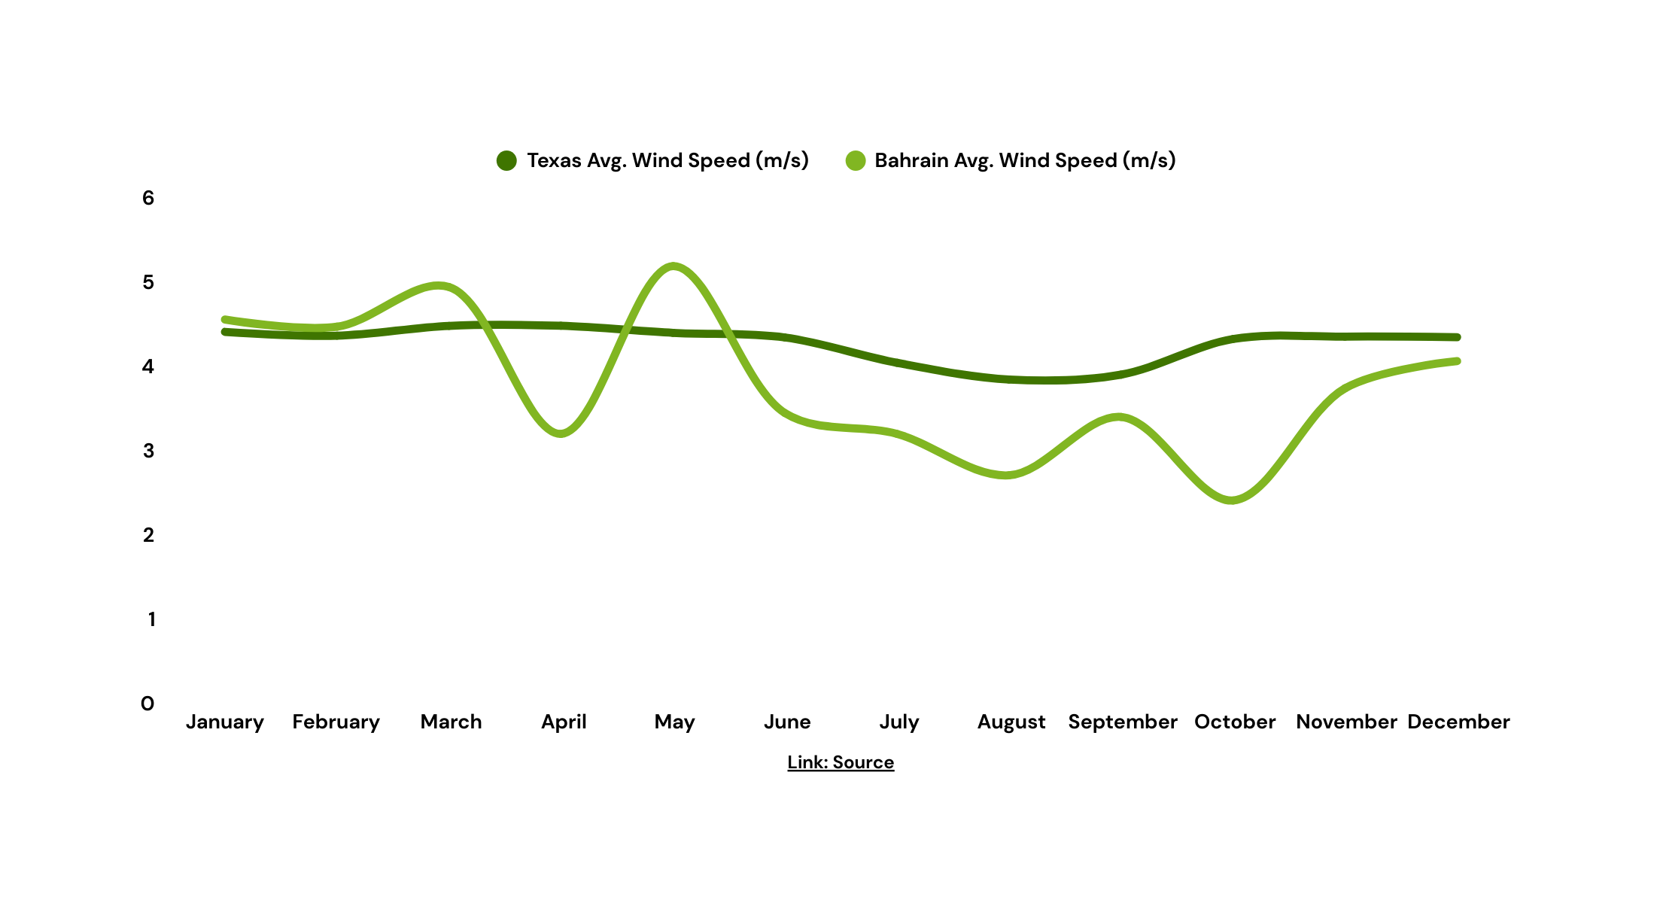
Renewable Energies
1- Wind Energy

Slide 32
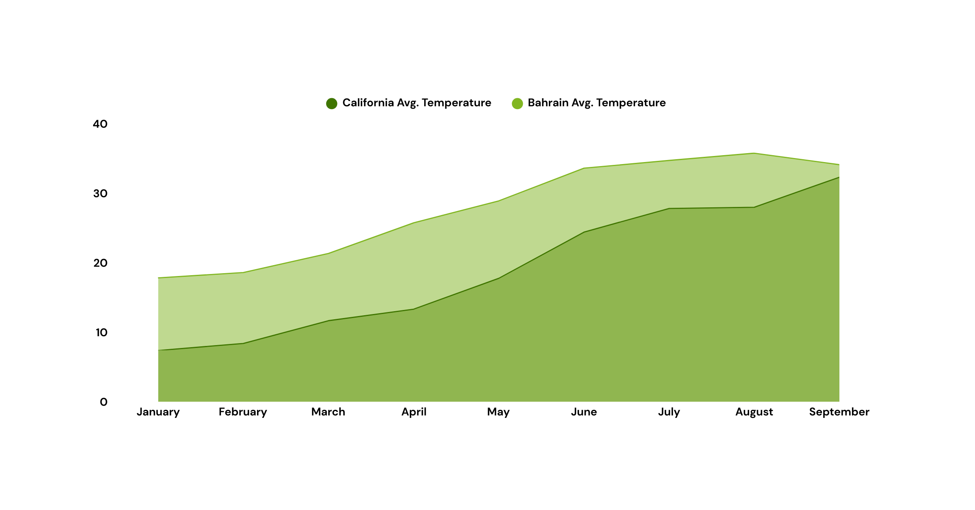
Renewable Energies
2- Solar Energy
36
32.3
17.8
7.4

Slide 33




Renewable Energies
2- Solar Energy
Bahrain’s Total Consumption (2023)
Eleven Miles Solar Hybrid
40,000 GWh
8.1 Km
$ 1 billion
441 GWh
Requirements to Cover Bahrain’s Consumption
734 Km
$ 90.6 billion
40,000 GWh

Slide 34
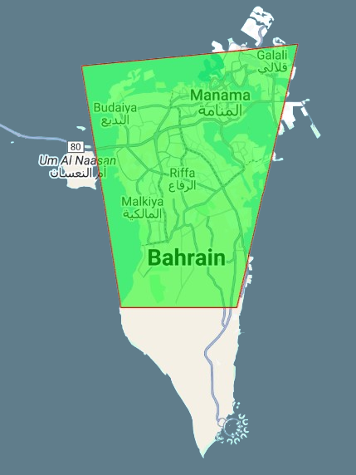

Slide 35
Renewable Energies
3- Nuclear Energy
Bahrain’s Total Consumption (2023)
Callaway Nuclear Generation Station
40,000 GWh
11.2 Km
$ 5.9 billion
88,000 GWh
Requirements to Cover Bahrain’s Consumption
5.1 Km
$ 2.7 billion
40,000 GWh

Slide 36
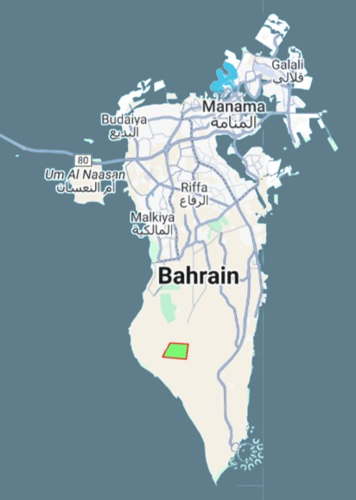

Slide 37
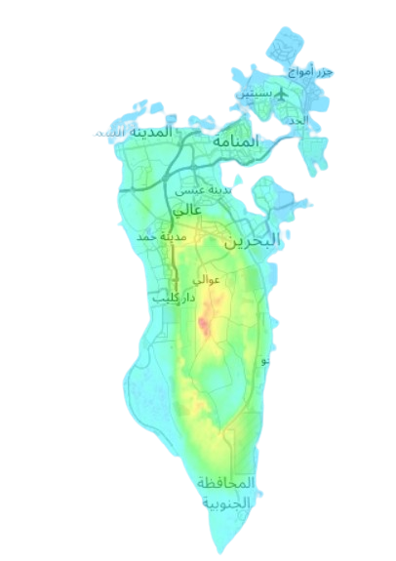
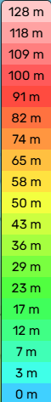
Renewable Energies
4- Hydroelectric Energy
No Rivers or Large Fresh Water Source
Flat Topography

Slide 38
Renewable Energies
5- Geothermal Energy
Bahrain’s Total Consumption (2023)
McGinness Hills Geothermal Complex
40,000 GWh
1 Km
$ 316.3 million
4,600 GWh
Requirements to Cover Bahrain’s Consumption
8.7 Km
$ 2.8 billion
40,000 GWh

Slide 39

Renewable Energies
Summary
Renewable Energy | Area | Fixed Cost | O & M Cost | Generation / Area
Wind | High | Mid | Mid | Mid
Solar | High | Mid | Mid | Mid
Nuclear | Mid | High | High | High
Geothermal | Low | Low | High | High
Hydroelectric | High | High | Low | Low

Slide 40


Conclusion
Renewables Share
Nuclear
Candidates
Highest Contribution
Nuclear
36.3%
Highest Efficiency
Geothermal

Slide 41



Recommendation
Comprehensive Comparison
Nuclear Energy Education
Solar System Footprint

Slide 42


Thank You

